Slide 1
PRESIDENCY UNIVERISTY, BENGALURU, School of Engineering
Computer Organization and Architecture
CSE 2257
Module-3: Arithmetic Unit

Slide 2
Introduction
A basic operation in all digital computers is the addition or subtraction of two numbers.
In this chapter we discuss about the logic circuits used to implement arithmetic operations.
The time needed to perform an addition operation affects the processor’s performance.
Multiply and divide operations, which require more complex circuitry than either addition or subtraction operations, also affect the performance.
In this chapter we discuss about some of the techniques used in modern computers to perform arithmetic operations at high speed.
Compared with arithmetic operations, logic operations are simple to implement using combinational circuits.

Slide 3
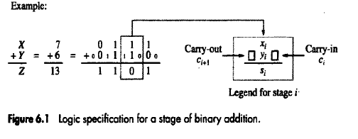
Addition And Subtraction Of Two Numbers
Consider the addition of two numbers X and Y with n-bits each.
Figure shows the logic truth table for adding equally weighted bits Xi and Yi in two numbers X And Y.
The figure also shows the logic expressions for these functions, along with an example of addition of 4-bit unsigned numbers 7 and 6.
The logic expression for sum (S_{i}) and the carry out function (C_{i+1}) are shown in the figure.

Slide 4
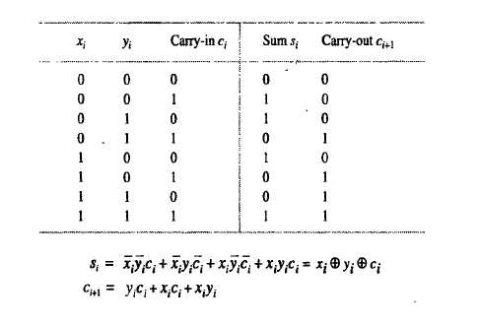

Slide 5
Adder
FULL ADDER:
The circuit which performs the addition of three bits is a Full Adder.
It consists of three inputs and two outputs.
INPUTS:
Xi, yi and ci are the three inputs of full adder.
OUTPUTS:
Si and Ci+1 are the two outputs of full adder.
Block diagram of full adder is shown in the figure.
A cascaded connection of n full adder blocks can be used to add two n-bit numbers. Since the carries must propagate or ripple through this cascade, the configuration is called an n-bit ripple-carry adder.
A cascaded connection of K n-bit adders can be used to add k n-bit numbers.

Slide 6
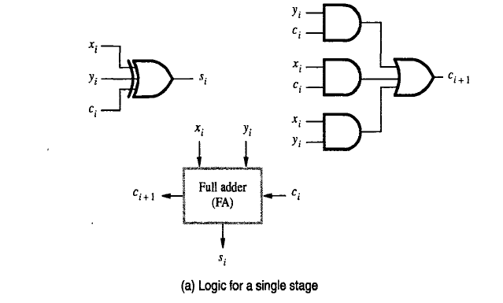

Slide 7
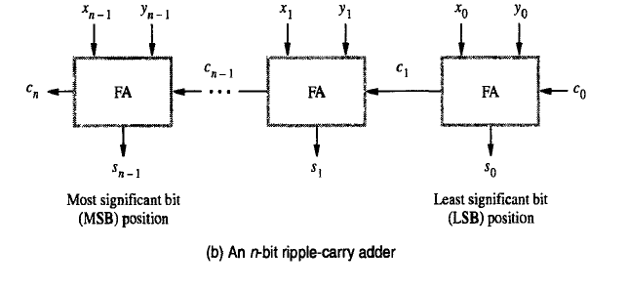

Slide 8
Computing the add time (contd..)
x₀
y₀
Consider 0th stage:
c₁ is available after 2 gate delays.
s₀ is available after 1 gate delay.
c₁
FA
c₀
s₀
Sum
Carry
y
i
c
i
x
i
y
s
x
i
c
i
i
c
i
i
+
1
c
i
x
y
i
i

Slide 9
Computing the add time (contd..)
Cascade of 4 Full Adders, or a 4-bit adder
x₀
y₀
x₀
y₀
x₀
y₀
x₀
y₀
FA
FA
FA
c₁
FA
c₀
c₄
c₃
c₂
s₃
s₂
s₁
s₀
s₀ available after 1 gate delays, c₁ available after 2 gate delays.
s₁ available after 3 gate delays, c₂ available after 4 gate delays.
s₂ available after 5 gate delays, c₃ available after 6 gate delays.
s₃ available after 7 gate delays, c₄ available after 8 gate delays.
For an n-bit adder, s_{n-1} is available after 2n-1 gate delays
c_{n} is available after 2n gate delays.

Slide 10
What’s the problem with normal addition?
When we add binary numbers using the Ripple Carry Adder, each bit has to wait for the carry from the previous bit.
Example: If you’re adding 8-bit numbers, the carry must “ripple” through all 8 bits. This makes it slow.
Carry Look-Ahead Adder (CLA) — The Faster Way
The Carry Look-Ahead Adder solves this problem by calculating the carry in advance, instead of waiting for it to ripple bit by bit.

Slide 11
Fast addition
(Carry-look Ahead Addition)
Recall the equations:
Second equation can be written as:
We can write:
G_{i} is called Generate function and P_{i} is called Propagate function
G_{i} and P_{i} are computed only from x_{i} and y_{i} and not c_{i}, thus they can be computed in one gate delay after X and Y are applied to the inputs of an n-bit adder.

Slide 12
The expressions G_{i} and P_{i} are called the generate and propagate functions for stage i.
Each bit stage contains an
1) AND gate to form Gi,
2) OR gate to form Pi, and
3) three-input XOR gate to form Si.
A simpler circuit can be designed to generate Gi, Si and Pi
But in this case Gi=1, so it does not matter whether Pi is 0 or 1.
Then using a cascade of two input XOR gates to realize the 3-input XOR function. the basic cell B can be used in each bit stage as shown in the figure.

Slide 13
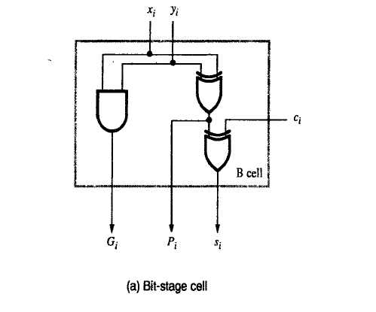
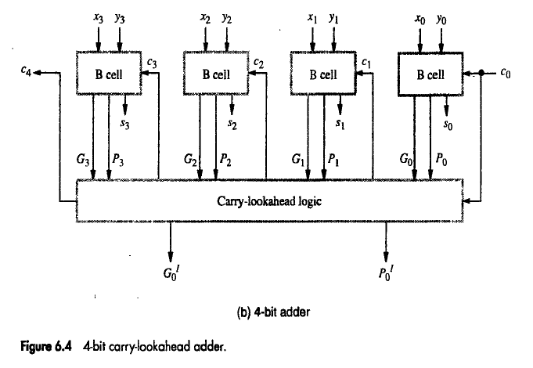

Slide 14
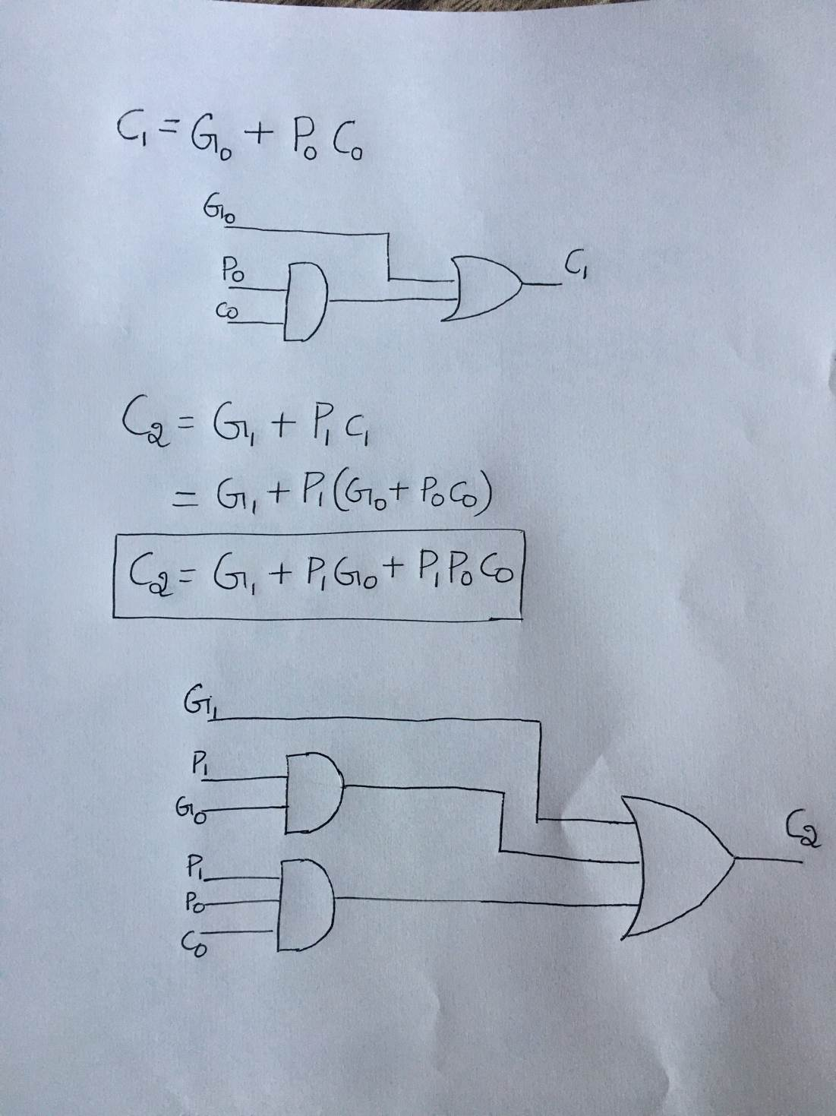
i = 0
C₁= 3GD
i = 1
C₂= 3GD

Slide 15
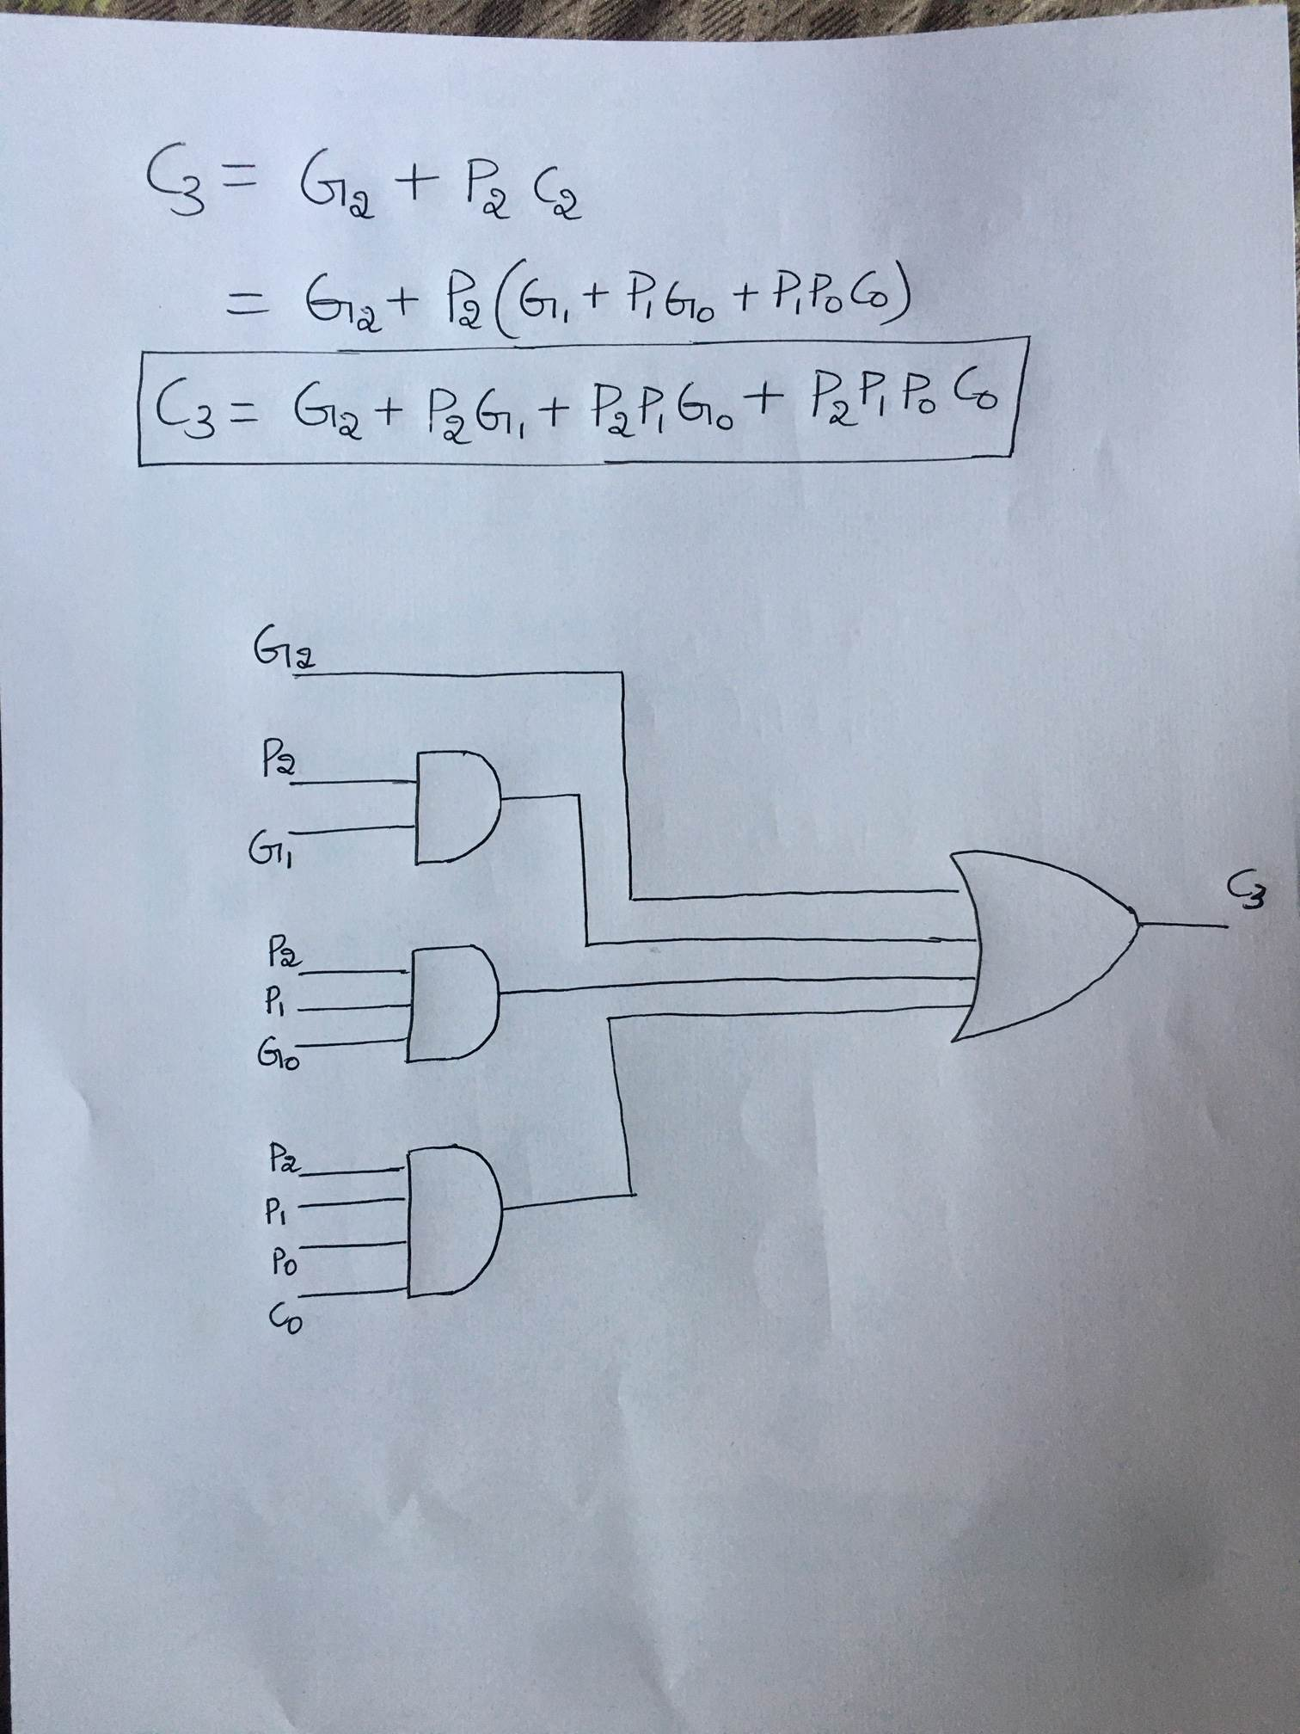
i = 2
C₃= 3GD

Slide 16
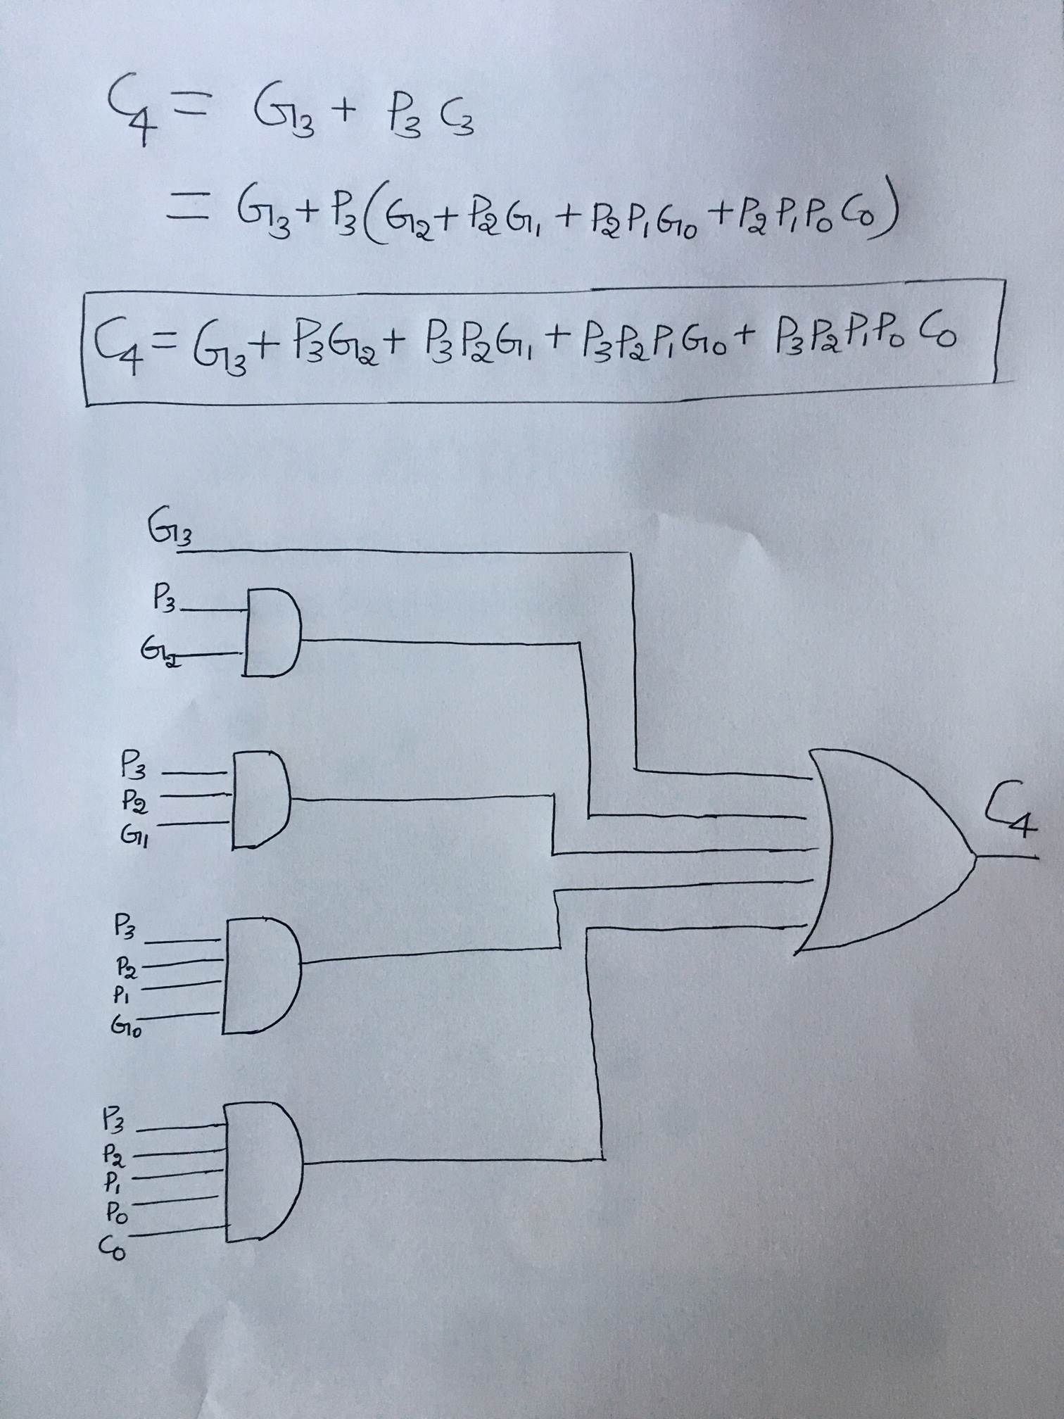
i = 3
C₄= 3GD

Slide 17
For example the carries in a four stage carry-look ahead adder is given as follows.
C₁= G₀+P₀C₀
C₂=G₁+P₁C₁
= G₁+ P₁(G₀+P₀C₀)
= G₁+P₁G₀+P₁P₀C₀
C₃= G₂+P₂C₂
= G₂+P₂(G₁+P₁G₀+P₁P₀C₀)
= G₂+P₂G₁+P₂P₁G₀+P₂P₁P₀C₀

Slide 18
C₄= G₃+P₃C₃
= G₃+P₃(G₂+P₂G₁+P₂P₁G₀+P₂P₁P₀C₀)
= G₃+P₃G₂+P₃P₂G₁+P₃P₂P₁G₀+P₃P₂P₁P₀C₀

Slide 19
P_{i} and G_{i}:
All Pi and Gi are available after one gate delay.
C_{i+1}:
All carries are available after three gate delays.
Sum:
After a further XOR gate delay, all sum bits are available. So after four gate delays all sums are available.

Slide 20
An adder implemented in this form is called a carry-look ahead adder.
Delay through the adder is 3 gate delays for all carry bits and 4 gate delays for all sum bits.
In comparison 4-bit ripple carry adder requires 7 gate delays for all sums and 8 gate delays for all carries.

Slide 21
MULTIPLICATION
Signed-operand Multiplication using Sign-Extension Method
2. BOOTH’S Algorithm

Slide 22
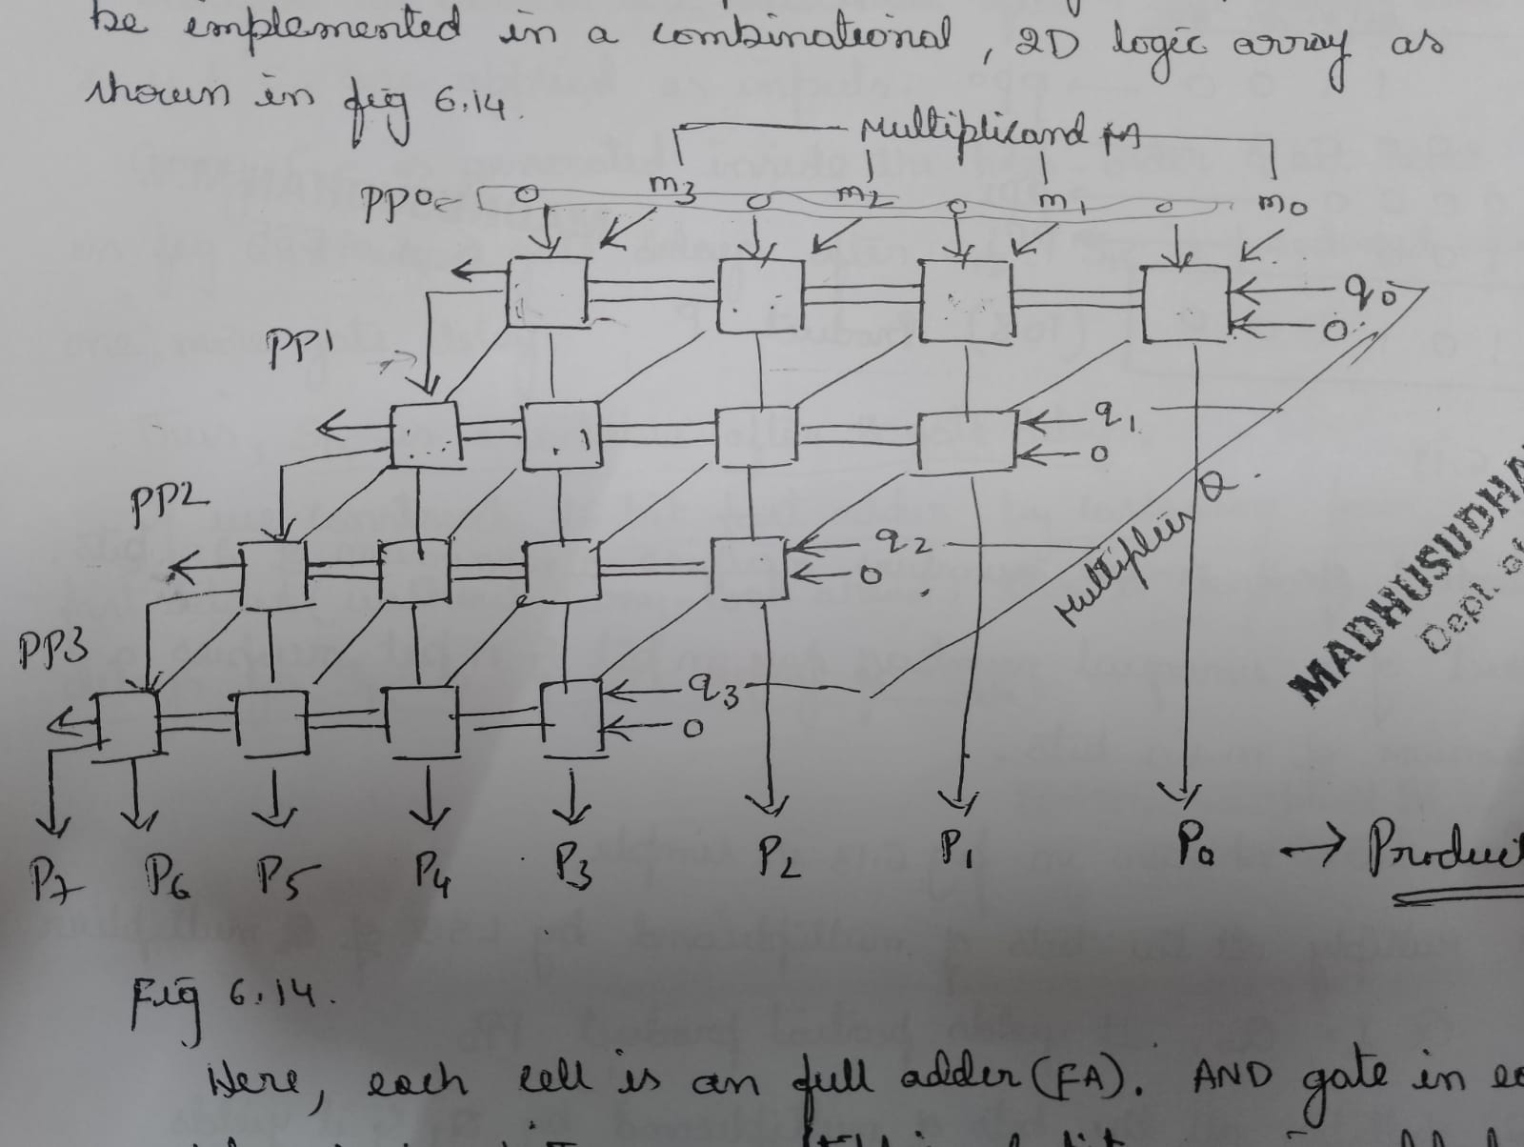

Slide 23
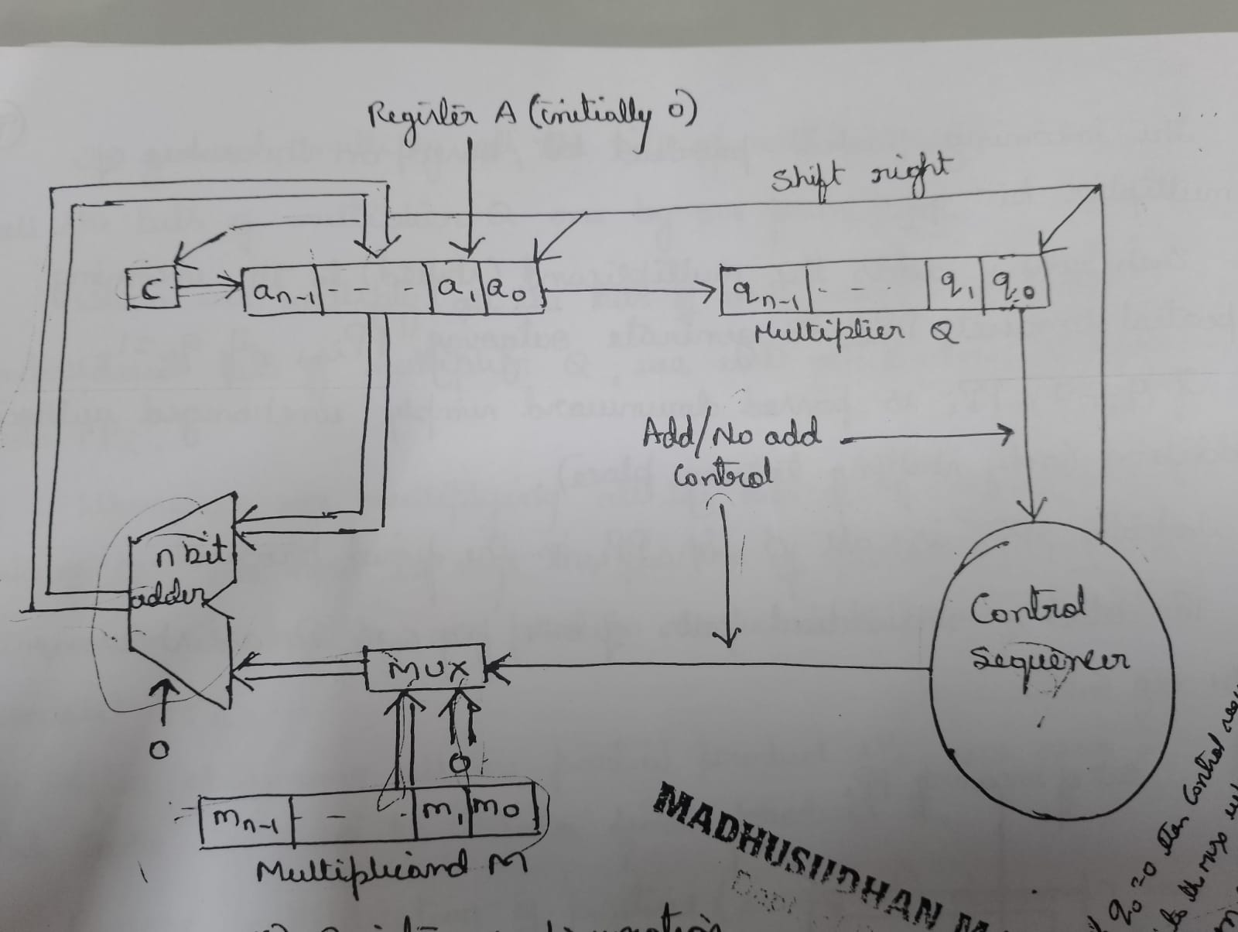

Slide 24
This process uses add-shift logic, similar to unsigned multiplication but includes sign handling.
Step 1: Registers Used
Register A – Initially all 0s.
Register Q – Multiplier (contains the bits of the number we are multiplying with).
Register M – Multiplicand.
Register C – Carry bit (initially 0).
Control sequencer – Decides “Add” or “No Add” based on the multiplier bit.
Algorithm
Load the multiplicand (M), multiplier (Q), set A = 0 and C = 0.
Check the least significant bit (LSB) of Q (Q₀):
If Q₀ = 1 → Add M to A.
If Q₀ = 0 → No Add.
Perform Arithmetic Shift Right (ASR) — this shifts A, Q, and C together (keeping sign).
Repeat steps 2–3 for the number of bits in Q.
Final product is found by combining A and Q.

Slide 25
Component | Function
Register A | Accumulates partial sums
Register Q | Holds multiplier bits
Register M | Holds multiplicand bits
Register C | Carry bit during addition
Control Sequencer | Decides add/no-add and shift operations
Sign Extension | Keeps sign bit consistent after each shift
The sign extension method ensures that when you shift right (ASR), the sign bit (MSB) is preserved, keeping negative numbers valid in 2’s complement form throughout the operation.

Slide 26
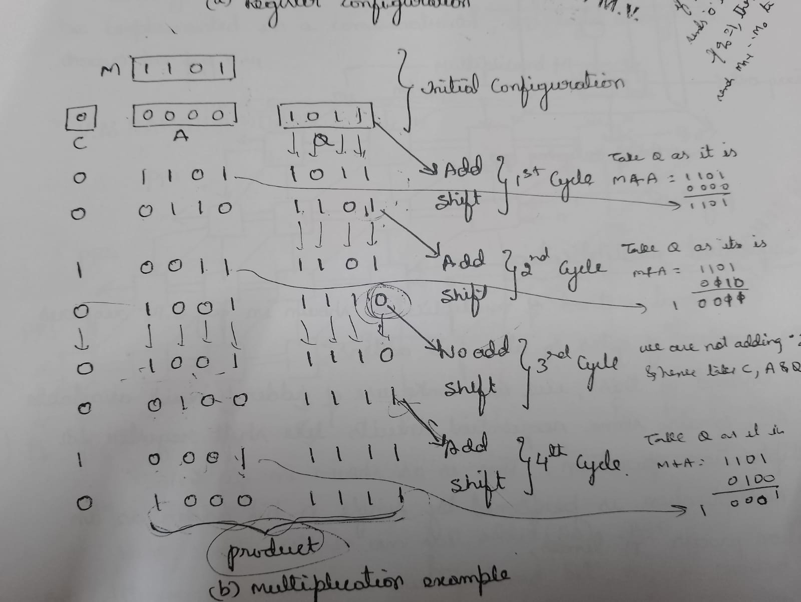

Slide 27
Signed-operand Multiplication(Sign Extension Method)
Considering 2’s-complement signed operands, what will happen to
(-13)×(+11) if following the same method of unsigned multiplication?
(-13) Multiplicand
X
(+11) Multiplier
1
0
1
0
1
(5 bits)
0
1
0
1
1
(5 bits)
1
1
1
1
1
1
0
0
1
1
1
1
1
1
1
0
0
1
1
Sign extension is
0
0
0
0
0
0
0
0
shown in blue
1
1
1
0
0
1
1
0
0
0
0
0
0
1
1
0
1
1
1
0
0
0
1
(
-
143
)
Sign extension of negative multiplicand.

Slide 28
Sign Extension
To handle signed multiplication using the same method as unsigned multiplication, the negative multiplicand is sign-extended. That means its sign bit (1 for negative) is replicated across the extended bits to preserve its value during the shift-and-add process.
So, 10011 becomes 111110011 (extended to 9 bits).
Partial Products
Each bit of the multiplier is used to generate a partial product:
If the bit is 1, the extended multiplicand is added.
If the bit is 0, a row of zeros is added. Each partial product is shifted left according to its bit position.
Summation
All partial products are added together, just like in unsigned multiplication. Because the multiplicand was sign-extended, the result correctly reflects the signed nature of the operation.

Slide 29
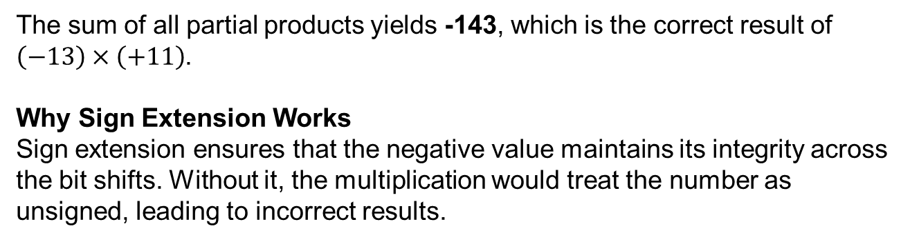
The sum of all partial products yields -143, which is the correct result of $\left(−13\right)×\left(+11\right)$.
Why Sign Extension Works
Sign extension ensures that the negative value maintains its integrity across the bit shifts. Without it, the multiplication would treat the number as unsigned, leading to incorrect results.

Slide 30
MULTIPLICATION
BOOTH’S Algorithm

Slide 31
Signed Multiplication
For a negative multiplier, a straightforward solution is to form the 2’s-complement of both the multiplier and the multiplicand and proceed as in the case of a positive multiplier.
This is possible because complementation of both operands does not change the value or the sign of the product.
A technique that works equally well for both negative and positive multipliers – Booth algorithm.

Slide 32
Booth Algorithm
Consider in a multiplication, the multiplier is positive 0011110, how many appropriately shifted versions of the multiplicand are added in a standard procedure?
0
1
0
1
1
0
1
0
0
+
1
+
1
+
1
+
1
0
0
0
0
0
0
0
0
0
1
0
1
1
0
1
0
1
0
1
1
0
1
0
1
0
1
1
0
1
0
1
0
1
1
0
1
0
0
0
0
0
0
0
0
0
0
0
0
0
0
0
0
0
1
0
1
0
1
0
0
0
1
1
0

Slide 33
Booth Algorithm
Since 0011110 = 0100000 – 0000010, if we use the expression to the right, what will happen?
0
1
0
1
1
0
1
0
+
1
0
0
0
-
1
0
0
0
0
0
0
0
0
0
0
0
0
0
0
0
2's complement of
1
1
1
1
1
1
1
0
1
0
0
1
1
the multiplicand
0
0
0
0
0
0
0
0
0
0
0
0
0
0
0
0
0
0
0
0
0
0
0
0
0
0
0
0
0
0
0
0
0
0
0
0
1
0
1
1
0
1
0
0
0
0
0
0
0
0
0
0
0
1
0
1
0
1
0
0
0
1
1
0

Slide 34
BOOTH’S Algorithm
The booth algorithm generates the 2n-bit product and treats both positive and negative 2’s complement n-bit operands uniformly.
In general, in the booth scheme, -1 times the shifted multiplicand is selected when moving from 0 to 1, and +1 times the multiplicand is selected when moving from 1 to 0.
Example:
Recode the multiplier 101100 for Booth’s algorithm?
Multiplier: 1 0 1 1 0 0 0
Recoded Multiplier: -1 +1 0 -1 0 0

Slide 35
Booth Algorithm
Multiplier
V
ersion of multiplicand
selected by bit
i
Bit
i
Bit
i
-
1
0
0
0
X
M
0
1
+
1
X
M
1
0
−
1
X
M
1
1
0
X
M
Booth multiplier recoding table.

Slide 36
Booth Algorithm
In general, in the Booth scheme, -1 times the shifted multiplicand is selected when moving from 0 to 1, and +1 times the shifted multiplicand is selected when moving from 1 to 0, as the multiplier is scanned from right to left.
0
0
1
0
1
1
0
0
1
1
1
0
1
0
1
1
0
0
0
+
1
-
1
+
1
0
-
1
0
+
1
0
0
-
1
+
1
-
1
+
1
0
-
1
0
0
Booth recoding of a multiplier.

Slide 37
Booth Algorithm
0
1
1
0
1
(
+
13
)
0
1
1
0
1
X
1
1
0
1
0
(
-
6
)
0
-
1
+1
-
1
0
0
0
0
0
0
0
0
0
0
0
1
1
1
1
1
0
0
1
1
0
0
0
0
1
1
0
1
1
1
1
0
0
1
1
0
0
0
0
0
0
1
1
1
0
1
1
0
0
1
0
(
-
78
)
Booth multiplication with a negative multiplier.

Slide 38
Booth Algorithm
Best case – a long string of 1’s (skipping over 1s)
Worst case – 0’s and 1’s are alternating
0
1
0
1
0
1
0
1
0
1
0
1
0
1
0
1
Worst-case
multiplier
+
1
-
1
+
1
-
1
+
1
-
1
+
1
-
1
+
1
-
1
+
1
-
1
+
1
-
1
+
1
-
1
1
1
0
0
0
1
0
1
1
0
1
1
1
1
0
0
Ordinary
multiplier
0
-
1
0
0
+
1
-
1
+
1
0
-
1
+
1
0
0
0
-
1
0
0
0
0
0
0
1
1
1
1
1
0
0
0
0
1
1
1
Good
multiplier
0
0
0
+
1
0
0
0
0
-
1
0
0
0
+
1
0
0
-
1

Slide 39
BOOTH’S Algorithm
(+45) Multiplicand
X
(+30) Multiplier
0
1
0
1
1
0
1
(7 bits)
0
0
1
1
1
1
0
(7 bits)
Booth Recoded Multiplier 0 1 0 0 0 -1 0
(7 bits)
0
0
0
0
0
0
0
0
0
0
0
0
0
0
1
1
1
1
1
1
1
0
1
0
0
1
1
0
0
0
0
0
0
0
0
0
0
0
0
0
0
0
0
0
0
0
0
0
0
0
0
0
0
0
0
0
0
0
0
0
0
0
0
1
0
1
1
0
1
0
0
0
0
0
0
0
0
0
0
0
1
0
1
0
1
0
0
0
1
1
0
(
+
1350
)

Slide 40
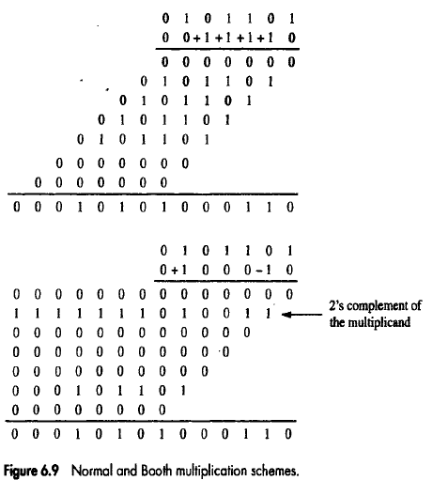

Slide 41
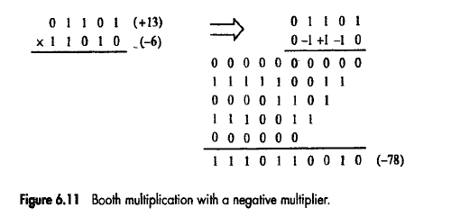

Slide 42
Integer Division
Restoring Division Algorithm

Slide 43
Manual Division
13
21
1101
10101
274
100010010
26
1101
14
10000
13
1101
1
1110
1101
1
Longhand division examples.

Slide 44
Longhand Division Steps
Position the divisor appropriately with respect to the dividend and performs a subtraction.
If the remainder is zero or positive, a quotient bit of 1 is determined, the remainder is extended by another bit of the dividend, the divisor is repositioned, and another subtraction is performed.
If the remainder is negative, a quotient bit of 0 is determined, the dividend is restored by adding back the divisor, and the divisor is repositioned for another subtraction.

Slide 45
Circuit Arrangement for binary division
Shift left
a_{n}
a_{n-1}
a₀
q_{n-1}
q₀
Dividend Q
A
Quotient
Setting
N+1 bit
adder
Add/Subtract
Control
Sequencer
0
m_{n-1}
m₀
Divisor M

Slide 46
Restoring Division
Figure in the previous slide shows a logic circuit arrangement that implements restoring division.
An n-bit positive divisor is loaded into register M.
An n-bit positive dividend is loaded into register Q at the start of the operation.
Register A is set to 0.
After the division is complete,
n-bit Quotient → Register Q
Remainder → Register A
The extra bit position at the end of both A and M accommodates the sign bit during subtractions.

Slide 47
Restoring Division Algorithm
The following algorithm performs the restoring division:
Do the following ‘n’ times:
Shift A and Q left one binary position.
Subtract M from A, and place the answer back in A.
If the sign of A is 1, set Q0 to 0 and add M back to A(that is, restore A); otherwise set Q0 to 1.
Figure 6.22 shows a 4-bit example as it would be processed by the circuit in the figure 6.21

Slide 48
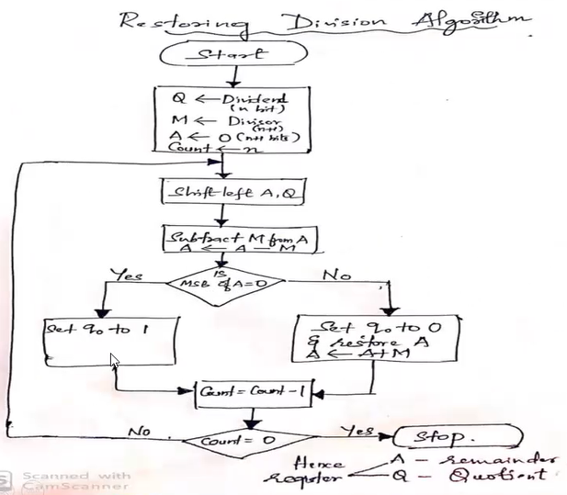
Restoring Division Algorithm Flowchart

Slide 49
Examples
Initially
0
0
0
0
0
1
0
0
0
0
0
0
1
1
Shift
0
0
0
0
1
0
0
0
Subtract
1
1
1
0
1
First cycle
Set
q
0
1
1
1
1
0
Restore
1
1
1
0
0
0
0
0
1
0
0
0
0
Shift
0
0
0
1
0
0
0
0
1
1
1
0
0
0
Subtract
1
1
1
0
1
1
1
Set
q
0
1
1
1
1
1
Second cycle
Restore
1
1
1
1
0
0
0
0
1
0
0
0
0
0
Shift
0
0
1
0
0
0
0
0
Subtract
1
1
1
0
1
Set
q
0
0
0
0
0
1
Third cycle
Shift
0
0
0
1
0
0
0
0
1
Subtract
1
1
1
0
1
0
0
1
Set
q
0
1
1
1
1
1
Fourth cycle
Restore
1
1
0
0
0
1
0
0
0
1
0
Remainder
Quotient
Figure 6.22. A restoring-division example.

Slide 50
Floating point numbers Representation
Fixed point numbers:
The decimal point is always assumed to be to the right of the least significant digit.
e.g. 4.0 , 12.0, 24.0
Limitations of Fixed point representation:
It has limitations.
Very large numbers cannot be represented, nor can very small fractions.
e.g. 1) 976,000,000,000,000.000
2) 0.0000000000000976
Therefore we use floating point representation

Slide 51
Floating point numbers:
The numbers in which the position of the decimal point is variable, such numbers are called Floating –point numbers.
e.g. 0.25, 12.5, 323.865
Advantage of Floating-point representation:
This allows a range of very large and very small numbers to be represented with only a few digits.
The number 976,000,000,000,000.000 can be represented as
9.76 * 10¹⁴
Similarly the fraction 0.0000000000000976 can be represented as 9.76*10⁻¹⁴
The decimal point is moved to convenient location and exponent of 10 to indicate the position of decimal point.
Placing a decimal point to the right of first (non zero) significant digit is called as normalization.

Slide 52
Floating point representation of Decimal numbers:
976,000,000,000,000.000 can be represented as 9.76 * 10¹⁴
0.0000000000000976 can be represented as 9.76*10⁻¹⁴
Therefore we can say floating representation has 3 components
1. sign
2. significant digits (mantissa)
3. Exponent
In case of the example above
Sign is +
significant digits (mantissa) 9.76
Exponent 14

Slide 53
Floating point representation of binary numbers:
The same approach can be taken with binary numbers.
e.g. Consider a number +111101.1000110
This can be represented in the floating point format.
+1.111011000110*2⁵ (Normalized form)
sign = 0
mantissa = 11101100110
Exponent = 5

Slide 54
NEED FOR A STANDARD FOR FLOATING REPRESENTATION
Data/ Instructions is a series of 0s and 1s.
To enable the processor to understand instructions have a word length.
Characters are also of fixed size (8 bits)
Similarly a floating point number also has to be of fixed size.
A floating point number has 3 components Sign, Magnitude and Exponents. Not only a floating point number also has to be of fixed size,the number of bits for each of these components also has to be fixed to be interpreted properly.
Consider a number A= 237.6867 it is represented in two ways
B= 2.376 *10² C=2.376867*10²
C is a more precise representation of A however it requires more digits.

Slide 55
Similarly consider a binary number A=+111101.1000110. It can be represented as B= +1.11*2⁵ C= +1.111011000110*2⁵
C is a more precise representation of A. However it requires more bits.
IEEE came up with two Standards for Floating point representation. Single precision ( 32 bit) and double precision (64 bit)
Simple applications require less precision hence Single precision is sufficient Ex Cost of grocery item. Scientific applications require high precision Ex diameter of cell. Diameter of the galaxy hence double precision.

Slide 56
IEEE Standards For Floating- Point Numbers
Single Precision Representation:
The 32-bit standard representation of floating point numbers is called a Single-Precision representation.
To represent a number we have seen we require Sign, Mantissa and exponent
In Single precision a number is represented with
1 bit for Sign
8 bits for Exponent
23 bits for Mantissa
Consider a number 10011101011.001 this will be represented as
0 10001001 00111010110010000000000
S E M

Slide 57
Sign:
The sign of the number is given in the first bit.
A number is either positive or negative. Hence to represent positive or negative numbers one bit is sufficient. Since one bit can hold 2 values
For positive numbers the sign bit is 0 and for negative numbers it is 1.

Slide 58
Exponent:
Exponent field contains the representation for the exponent. However exponent can be positive or negative
For example +111101.1000110 is represented as
+1.111011000110*2⁵ then Exponent = +5
+100000111011000110 is represented as
+1.111011000110*2⁻⁵ then Exponent = -5

Slide 59
Single precision uses 8 bits for exponent.
Those with 8 bits the maximum range is 2⁸ which is 256
Thus E΄ is in the range 0 ≤ E΄≤ 255.
The end values of this range 0 and 255 are used to represent special values.
Therefore the range of E΄ for normal numbers is 1 ≤ E΄≤ 254.
This means the actual exponent, E is in the range -126≤ E ≤ 127.
Positive and Negative exponent is stored as an unsigned integer, A signed exponent E is stored as E+127. This is called Excess 127 format.
For example An exponent E=+ 5 is stored as E+127 i.e 5+127=132.
An exponent E=- 5 is stored as E+127 i.e -5+127=122.

Slide 60
Mantissa:
The string of significant bits commonly called the mantissa.
The last 23-bits in single-precision represents the Mantissa.
Since the most significant bit of the mantissa is always equal to 1, this bit is not explicitly represented, it is assumed to be to the immediate left of the binary point.
Hence the 23-bits stored in mantissa field actually represent the fractional part of the Mantissa, this bits are right to the binary point.
The single-precision representation is shown in the figure below.

Slide 61
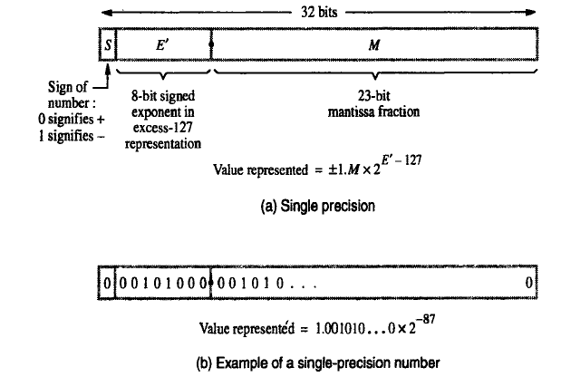

Slide 62
Double Precision Representation:
The 64-bit standard representation of floating point numbers is called a Double-Precision representation.
To represent a number we have seen we require Sign, Mantissa and exponent
In Single precision a number is represented with
1 bit for Sign
11 bits for Exponent
52 bits for Mantissa
Consider a number 10011101011.001 this will be represented as
0 10000001001 0011101011001000000000000000000000000000000000000000
S E M

Slide 63
Sign:
The sign of the number is given in the first bit.
A number is either positive or negative. Hence to represent positive or negative numbers one bit is sufficient. Since one bit can hold 2 values
For positive numbers the sign bit is 0 and for negative numbers it is 1.

Slide 64
Exponent:
Exponent field contains the representation for the exponent. However exponent can be positive or negative
For example +111101.1000110 is represented as
+1.111011000110*2⁵ then Exponent = +5
+100000111011000110 is represented as
+1.111011000110*2⁻⁵ then Exponent = -5

Slide 65
Double precision uses 11 bits for exponent.
Those with 8 bits the maximum range is 2¹¹ which is 2048
Thus E΄ is in the range 0 ≤ E΄≤ 2047.
The end values of this range 0 and 2047 are used to represent special values.
Therefore the range of E΄ for normal numbers is 1 ≤ E΄≤ 2046.
This means the actual exponent, E is in the range -1022≤ E ≤ 1023.
Positive and Negative exponent is stored as an unsigned integer, A signed exponent E is stored as E+1023. This is called Excess 1023 format.
For ex An exponent E=+ 5 is stored as E+1023 i.e. 5+1023=1028
An exponent E=- 5 is stored as E+1023 i.e. -5+1023=1018.
Mantissa:
The last 52-bits in single-precision represents the Mantissa.

Slide 66
Important
Example:
Represent 1259.125 in single precision and double precision formats.
the number 1259.125 has two parts
Integer part (1259)
Fractional part (125)
Step 1: convert the decimal number to binary format
Integer Part:
convert the integer part (1259) into binary format
1259 = 10011101011
Fractional part:
convert the fractional part to binary format
0.125*2 = 0.25 → 0
0.25*2 = 0.5 → 0
0.5* 2 = 1.0 → 1
0

Slide 67
hence
0.125 = 0.001
therefore
1259.125 = 10011101011 + 0.001
= 10011101011.001
Step2: Normalize the number
10011101011.001 = 1.0011101011001*2¹⁰
Single Precision Representation:
Sign:
The sign of given number is positive hence the sign bit is equal to 0.

Slide 68
Exponent:
the actual exponent E = 10
hence the exponent in excess 127-format is E’ is equal to E+127
E’ = 10 + 127 = 137
The binary representation of 137 is 10001001
E’ = 10001001
Mantissa:
the mantissa is equal to 0011101011001
hence M = 0011101011001……….0
hence the single precision representation of 1259.125 is given as
1259.125 = 0 10001001 00111010110010000000000
S E’ M

Slide 69
Double Precision:
In double precision representation 1 bit is used to indicate sign, 11 bits to represent the exponent and 52-bits to represent mantissa.
for a given number
sign = 0
exponent (E) = 10
Hence the exponent in excess- 1023 format (E’) is given as
E’ = E + 1023
= 10 + 1023
= 1033
The binary representation of 1033 is
E’ = 10000001001

Slide 70
Hence the double-precision representation of 1259.125 is given as follows
1259.125 = 0 10000001001 0011101011001000000000000000000000000000000000000000
S E’ M

Slide 71
End of Module 3

